Slide 1
5 me-nutes
Pablo Ramírez Moreta - prm@iaa.es

Slide 2
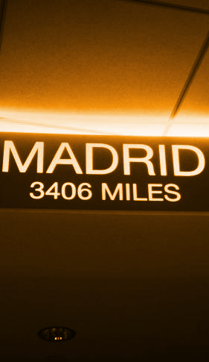
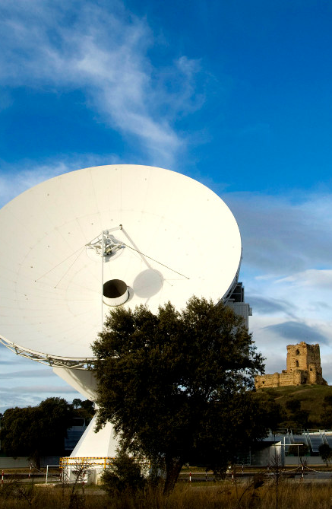

Slide 3
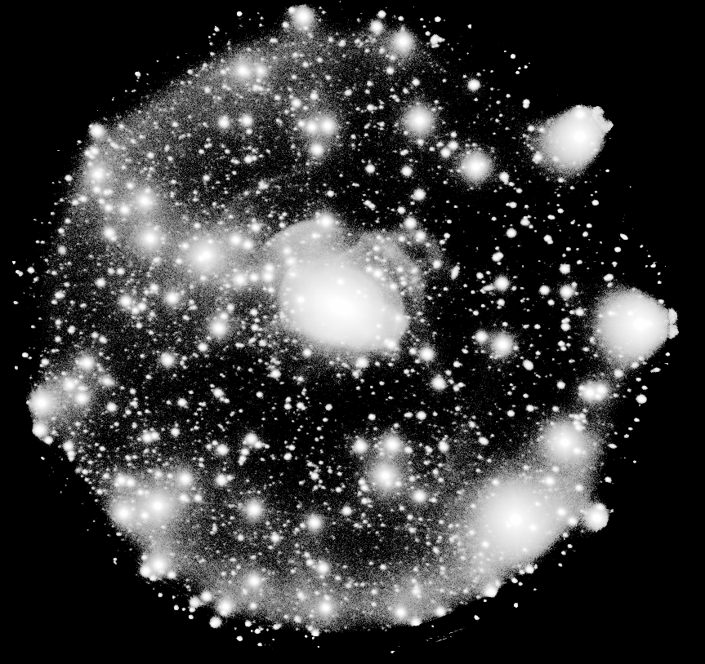
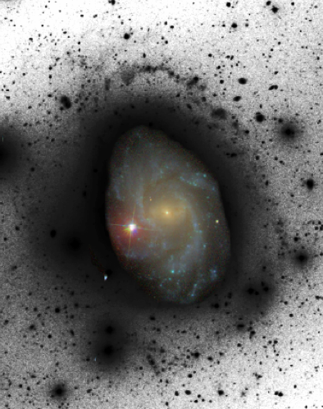
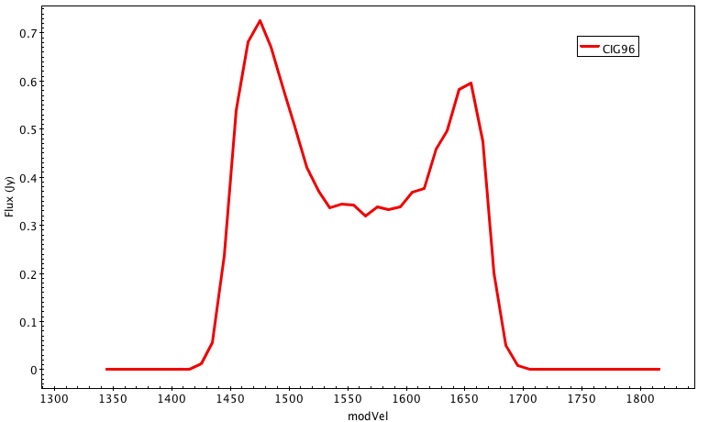
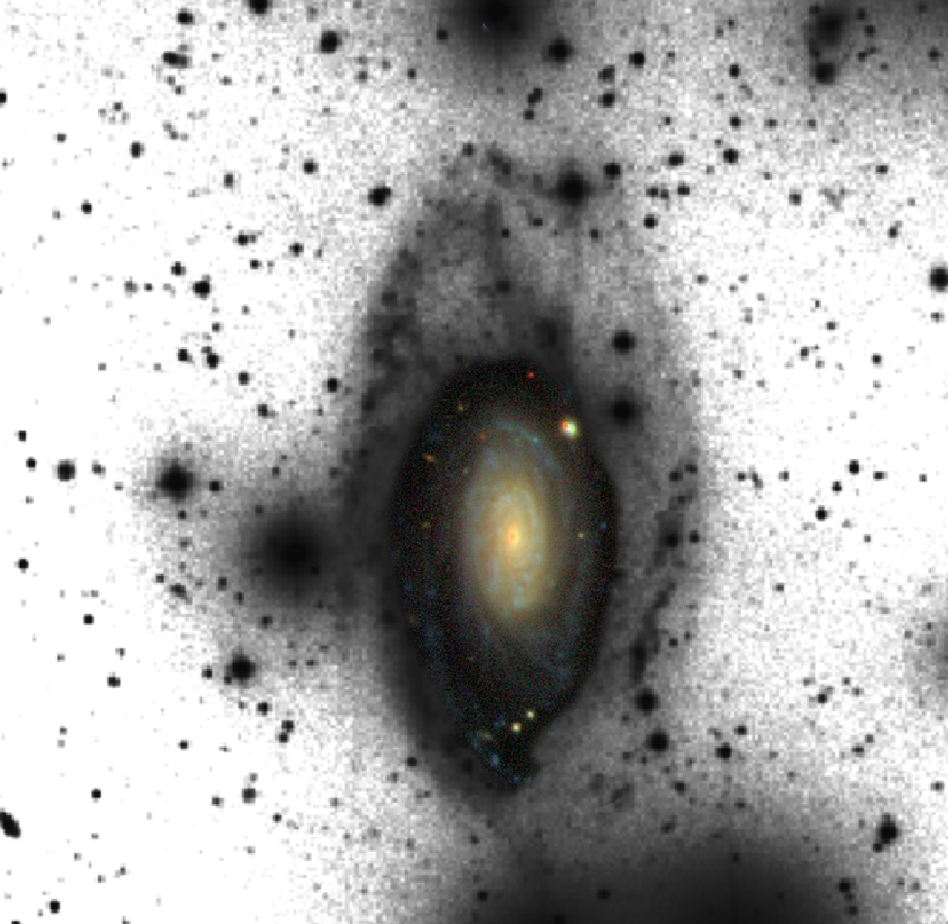
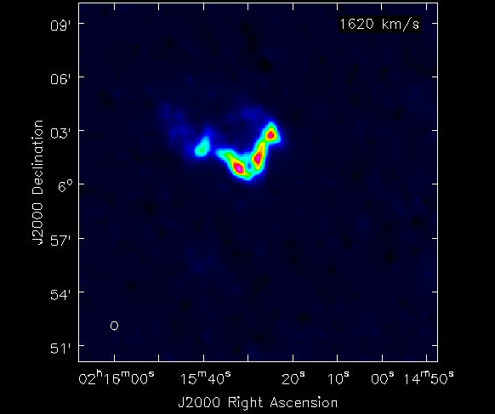
faint features in asymmetric & highly isolated galaxies
N_{HI} ~ 9 x 10¹⁸ at/cm²
m(r) ~ 27.5 mag/”² (4h)

Slide 4

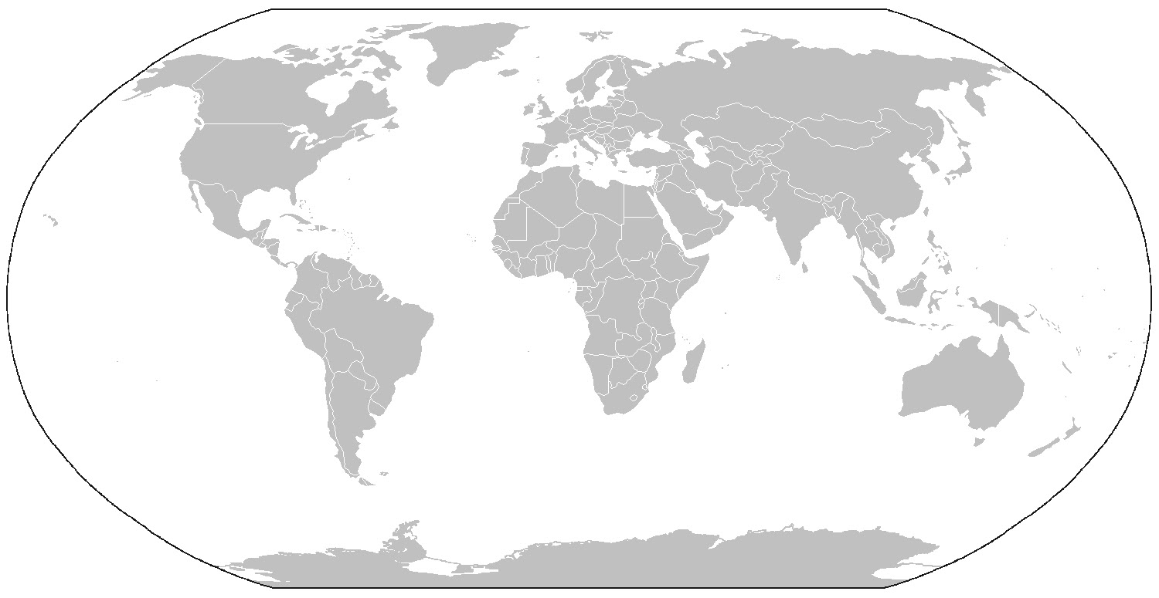

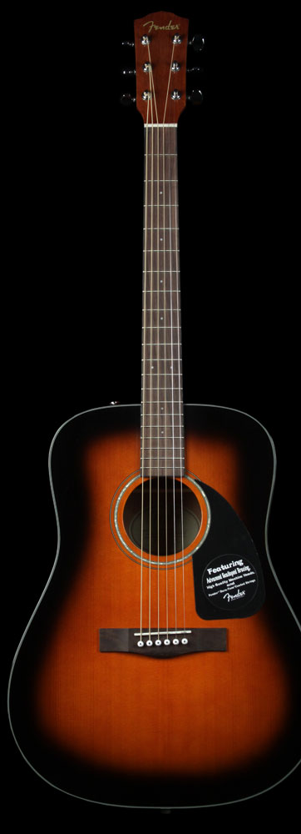



beyond astronomy

Slide 5
Pablo Ramírez Moreta - prm@iaa.es

